Slide 1
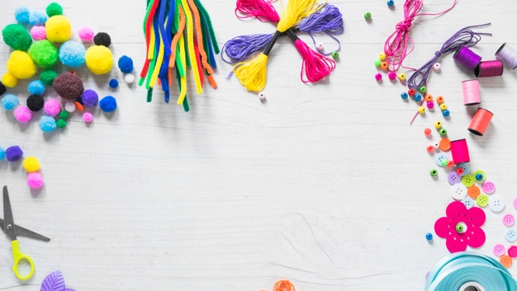
Live Laugh Life
Team Members:
Anindita Baishya | Bhavin Dave | Pooja Pokharna | Sindhura Kolli

Slide 2
INTRODUCTION
This is a project on an E commerce website that we are planning to integrate in the real time towards an initiative to prevent Child Labor.
The main concern leading to Child labor these days is lack of food and money. This is a major issue in India which has been going on since ages. And this brings the poverty line to a major downside towards India’s economy as well.
Our platform is to sell handicrafts created by Children of various NGOs, get them funds to create more such items and arrange them their day to day meals for the children and their family.

Slide 3

Technology Stack

Slide 4
Features

Slide 5

Features implemented so far
Search product
Search products based
on particular category
New arrivals
Best sellers
Product image
Product information
Product in stock/out of stock
View product
Related product
Add to cart
Remove product
Adjust quantity
Signin to checkout
User dashboard
Admin dashboard
Private routes
Admin routes
Shopping cart
Checkout with credit card
Checkout with delivery address
Success message
Update profile
Advance search of products
Advance search based on category and price range
Load more products
Admin dashboard
Create category
Create product
View orders
Manage products update/delete
Role based access

Slide 6
home page

Slide 7

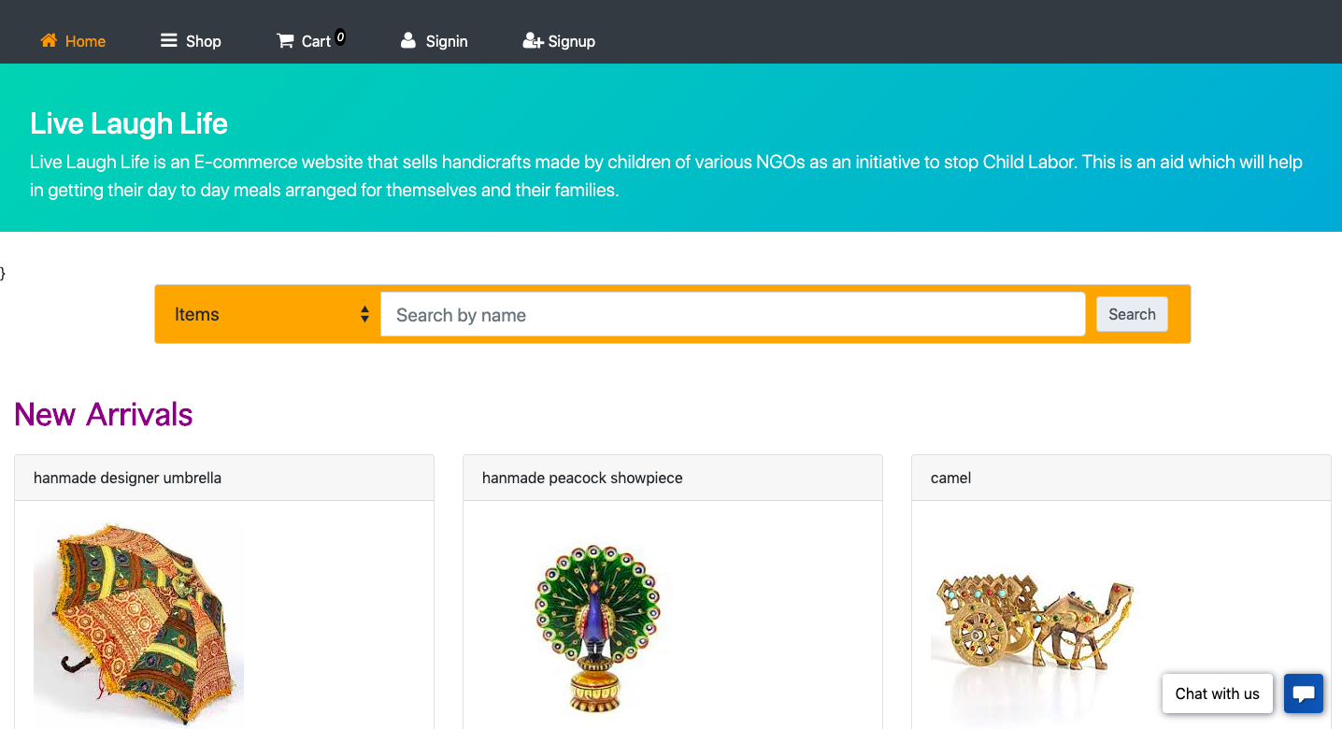
home page
It contains the introduction of the website
And have the products listed
To access the website we will login next

Slide 8
Sign up

Slide 9
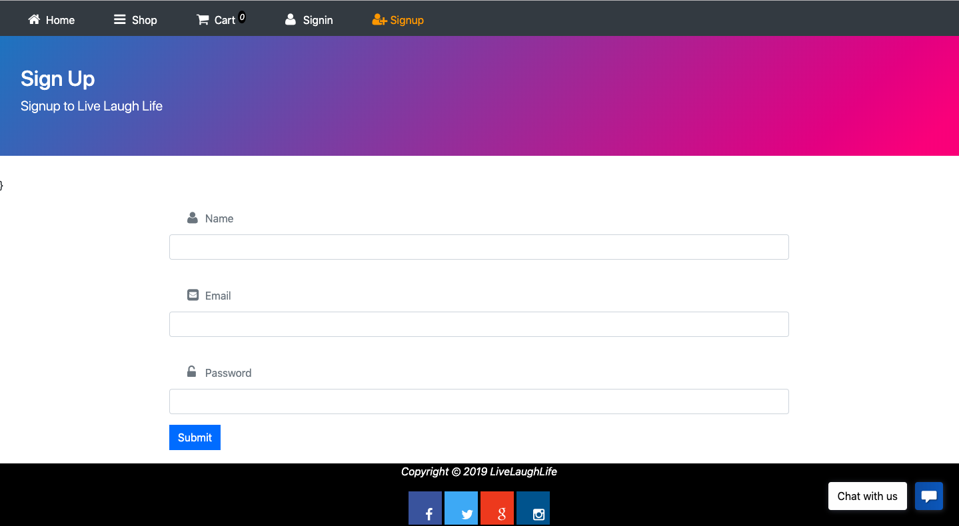
Sign up
It lets you to create a user by:
Name
Email
Password

Slide 10
Login

Slide 11
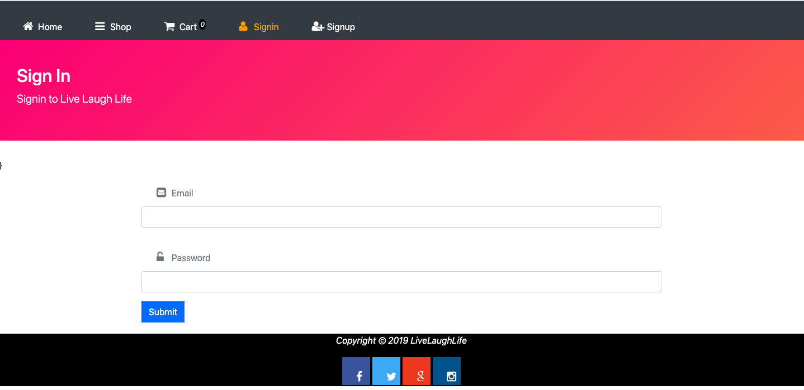
Login page
Insert the Email Id
Password
Click on submit
All fields are validated

Slide 12
products

Slide 13
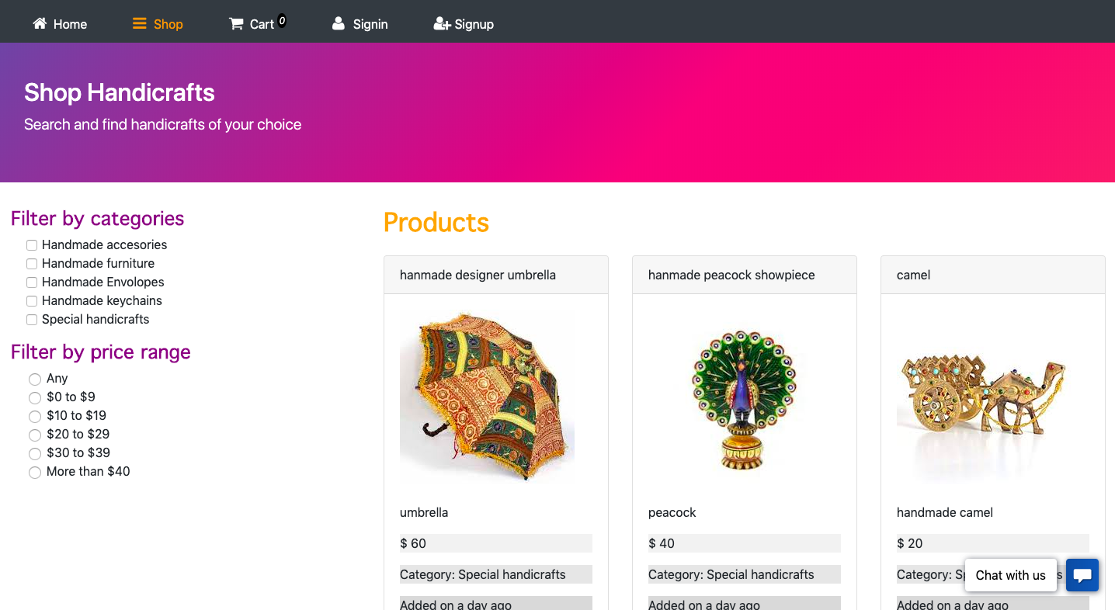
products
The features by products can be selected are:
Filter by categories
Filter by price range

Slide 14
ADD TO CART

Slide 15
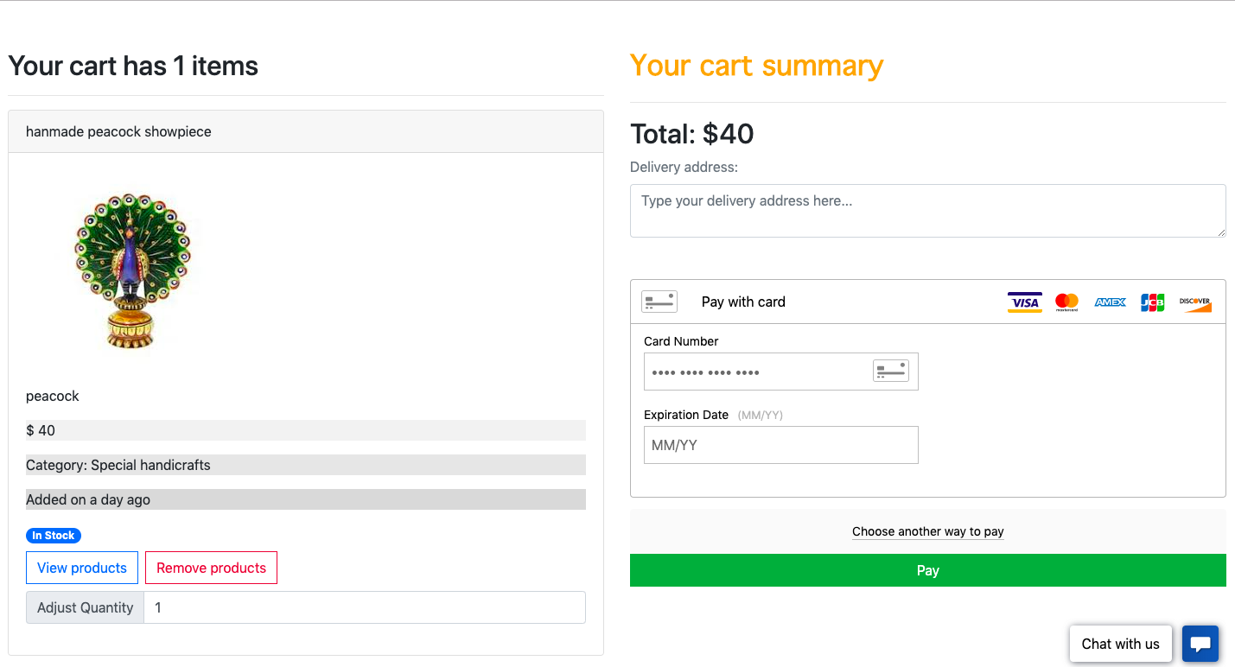
ADD TO CART
Product is added to cart
Features:
Add more products
View product of the same category
Remove product
Click on payment

Slide 16
PAYMENT

Slide 17
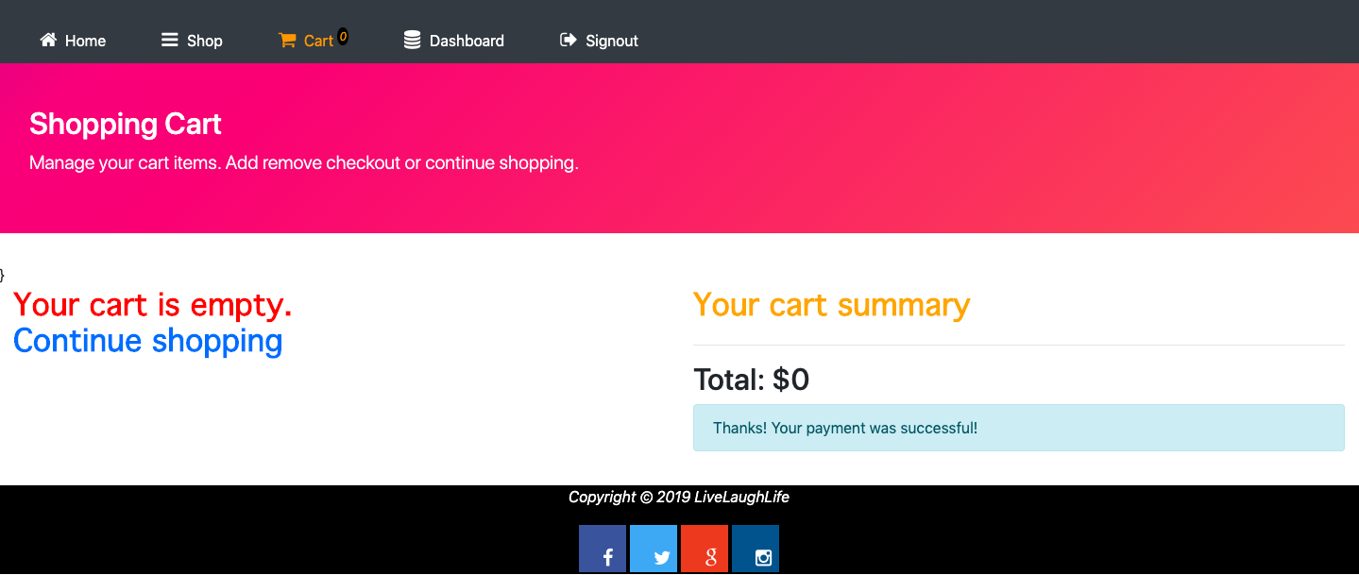
PAYMENT
Used Braintree sandbox to integrate with the payment
Payment is made with credit/debit card details
On successful payment, the message is displayed

Slide 18
dashboard

Slide 19
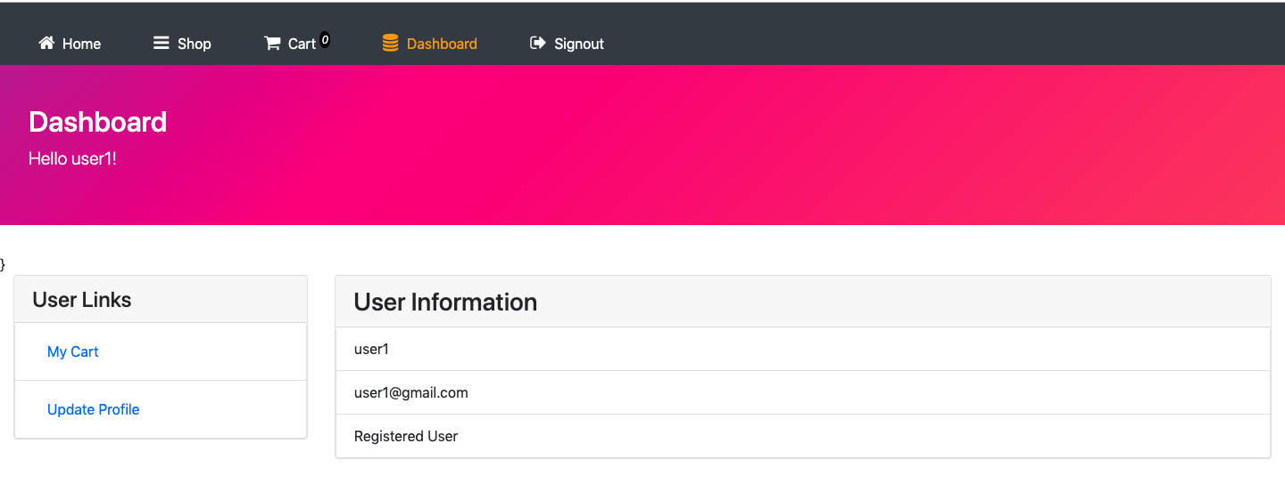
dashboard
Dashboard displays the user login information
It gives detail information about the profile
Has an option to update profile

Slide 20
Additional features

Slide 21
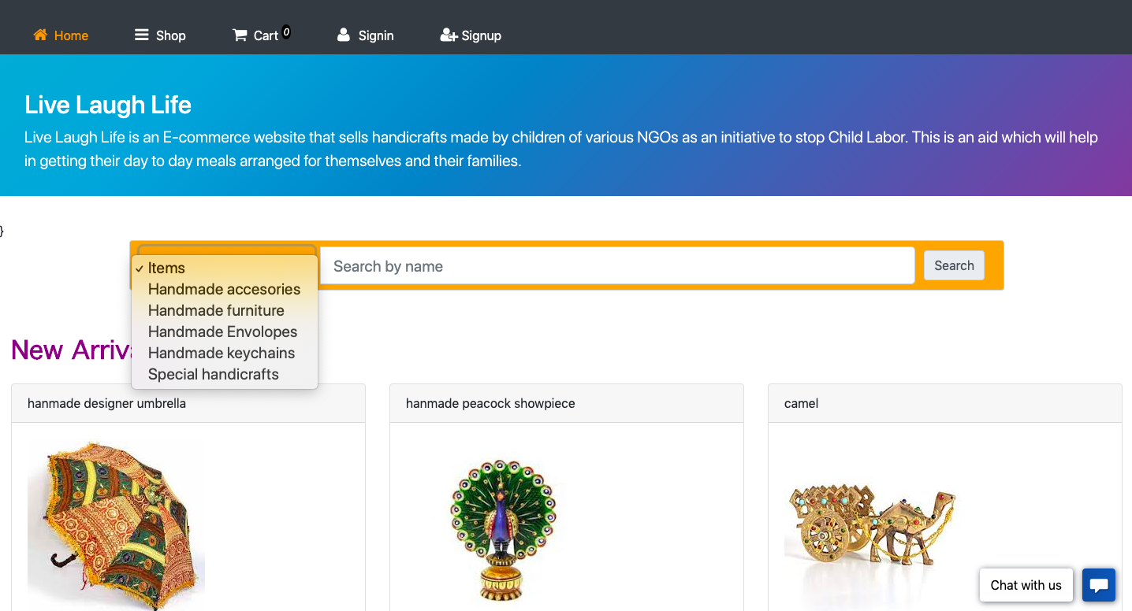
ADDITIONAL FEATURES
Product page has additional features
Products can be sorted and selected using the options:
Handmade accessories
Handmade furniture
Handmade Envelopes
Handmade Keychains
Special Handicrafts

Slide 22
CONCLUSION & FUTURE SCOPE
Achieved end to end functionality for the user who can place an order successfully.
Created a responsive website
Added filters for faster search of product
Added validations in every fields
This website can be hosted on cloud i.e. in the real time environment in future.
More functionalities can be implemented for admin role in future.
This can extend its support to more networks

Slide 23
REFERENCES
https://reactjs.org/docs/getting-started.html
https://www.mongodb.com/what-is-mongodb
https://nodejs.org/en/
https://expressjs.com/
https://www.bootstrapcdn.com/fontawesome/
https://www.w3schools.com/whatis/whatis_react.asp
https://www.youtube.com/watch?v=DLX62G4lc44
https://www.udemy.com/

Slide 24
THANK YOU ☺

